Slide 1
Trip Assistant App
Authors:
John Humbracht
Eric Simmons
Zac Talley
Mario Cortes

Slide 2

In a Nutshell
This application was developed with the purpose of creating a tool that will be helpful for any person that will be travelling to a place that they may not be familiar with.
It leverages existing third party APIs to provide the user with information that may be relevant for it’s upcoming trip.
Additionally, it utilizes the browser’s as a database to save their data; thus, avoiding the need for external data storage such as physical or cloud servers.

Slide 3
Concept / User Story
Whether you are a seasoned traveler or this is your first time visiting an unfamiliar place, all trips require proper planning.
Will it be sunny or rainy?
Where am I going to go for dinner?
If the kids get bored, where can I take them to have some fun?
I’d like to go meet some locals at a bar but where can I find one?
These are just some questions that may pop up at anytime when planning or during a trip. Well now…
There’s an app for that!
The objective of this application is to provide some level of assistance to any user who is planning a trip. By using the app, they will be able to research places of interest by category close to their trip destination. Also, by providing the user with the weather forecast, they are able to make better selections as to which places they would like to visit.
Additionally, the application provides users with an itinerary tool that allows them to add the places they would like to check out for planning and reference.
All of these within just one app!

Slide 4
Technologies Used
In creating this app, these are some of the technologies/skills that were used:
CSS Framework
Grid
API’s (server-side and local)
OpenWeatherMap
OpenTripMap
Browser’s Local Storage
GitHub
Version Control
Projects
Libraries
Moment JS
jQuery

Slide 5
Process /Challenges
Initially, the project was broken down into multiple areas:
UI
API calls
Data storage functions
Within each of these areas, additional tasks were identified. Even though each collaborator focused on one of the areas, as challenges emerged, the whole team would assist to find a solution.
Challenges
Ran into multiple issues regarding limitations and accessibility into APIs
Referencing multi-level objects in local storage
Scoping issues
Working with date objects
Project Management and Planning

Slide 6
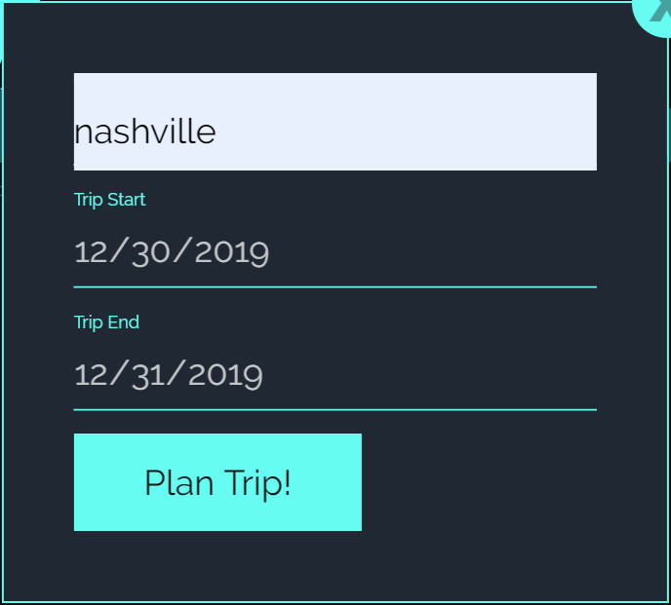

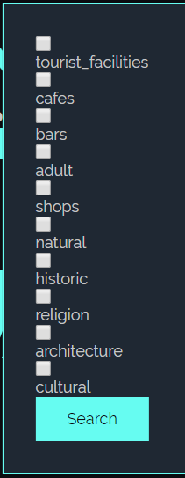
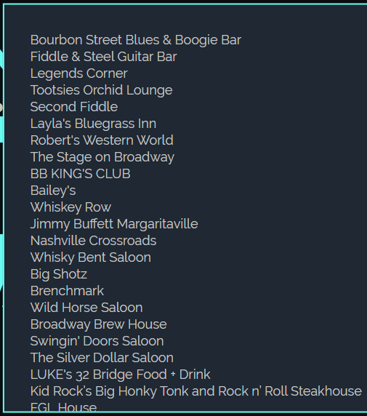
Live Demo / Links
Link to repository:
https://github.com/jhumbrac/tripassistant
Link to live site:
https://jhumbrac.github.io/tripassistant/

Slide 7

Future Development
Multi-user functionality
Feature to remove dates from trip
Feature to remove entire trips from database
Display additional details for places
Advanced search options:
Radius
# of results

